Slide 1
Operating Systems 2
Lectures: Dr Eoin O’Connell Labs: Dr Eoin O’Connell

Slide 2
Outline
Course Information
What is an OS?
History of OSes
Hardware Review
A Typical UNIX
Dual-Mode CPU Operations
Interrupts and System Calls
OS Major Components

Slide 3
Info About Me
Eoin O’Connell
20 Years working in UL.
PhD in Wireless Sensor Networks
Masters Degree in Business Admin
Honours Degree in Telecommunications
Ordinary Degree in Electronics
Research interests:
Mobile systems, networks, security, analytics
Computer networking, wireless communications
Extended Reality, Cyber Physical systems

Slide 4
Assessments
Final Assignment - 50%
Assignments – 50%
Mid-Term Online Assessment 15% (Week 7)
Mini Assignment 15% (Week 5)
Mini Assignment (labs based) 20% (Week 11)
Labs will start in Week 3
Tutorials start in Week 4

Slide 5
Class/Lab Etiquette
Be on time (if you are late enter the class quietly)
Your ringtone is not that great! (phones off or muted)
All online lectures are recorded….be mindful of that.
Have a webcam, no need to be on all the time.
You can do without Facebook/Youtube/Twitter
– If you have to, don’t disturb your peers
Interrupt for questions there is no dumb question….So they say!
Feel free to contribute....Anytime!

Slide 6

Problems with Module??
If you are having problems with any aspect of the module….feel free to email me.
Eoin.oconnell@ul.ie
Or call to my office…B2005A

Slide 7
Course Objectives
Understand functions and structures of operating systems
Processes & Synchronization
Memory System
File Systems
I/O Systems
Understand issues in the design of operating systems

Slide 8
Outline
Course Information
What is an OS?
History of OSes
Hardware Review
A Typical UNIX
Dual-Mode CPU Operations
Interrupts and System Calls
OS Major Components

Slide 9
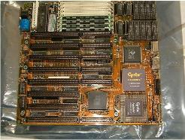
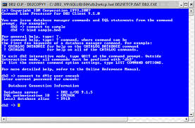
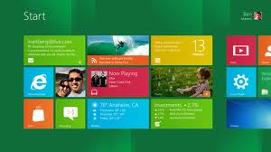
Why do we need Operating Systems?
We have hardware, but how to control it?
Mainframe computers
Hardware – Command Line – Graphical User Interface

Slide 10
What is an OS? (1)
Providing Services:
Abstraction
Convenience
Standardization
System and
Application
Programs
Resource Management:
Allocation
Reclamation
Protection
Virtualization
OS
Hardware
Program that acts as an intermediary between system/app programs and the computer hardware

Slide 11
What is an OS? (2)
Resources
Allocation
Reclamation
Protection
Virtualization
Examples:
CPUs
Memory
I/O devices

Slide 12
What is an OS? (3)
Resources
Allocation
Reclamation
Protection
Virtualization
Examples:
Voluntary at runtime
Implied at termination
Preemptive

Slide 13
What is an OS? (4)
Resources
Allocation
Reclamation
Protection
Virtualization
Protect resources from unauthorized access
Related to reliability and security

Slide 14
What is an OS? (5)
Resources
Allocation
Reclamation
Protection
Virtualization
Examples:
Virtual memory
Timeshared CPU

Slide 15
What is an OS? (6)
Resources
Allocation
Reclamation
Protection
Virtualization
Topic: Real life analogies of Operating Systems?
3-4 students per group
3-minute discussion

Slide 16

What is an OS? (7)

Slide 17
Outline
Course Information
What is an OS?
History of OSes
Hardware Review
A Typical UNIX
Dual-Mode CPU Operations
Interrupts and System Calls
OS Major Components

Slide 18
History of Operating Systems
First generation: 1945–1955
Vacuum tubes and plugboards (no OS)
Second generation: 1955–1965
Transistors, batch systems
Third generation: 1965–1980
Integrated circuits and multiprogramming
Fourth generation: 1980–present
Personal computers, mobile devices, sensors

Slide 19
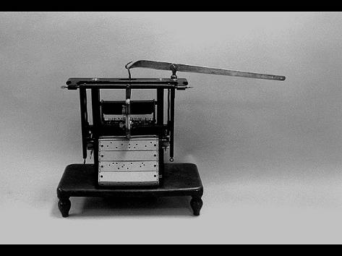
History of Computers - 19th Century
Jacquard Loom - 1801
first stored program - metal cards
first computer manufacturing
still in use today!

Slide 20
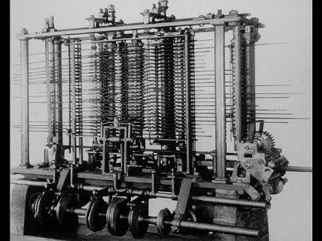
Charles Babbage - 1792-1871
Difference Engine c.1822
huge calculator, never finished
Analytical Engine 1833
could store numbers
calculating “mill” used punched metal cards for instructions
powered by steam!
accurate to six decimal places

Slide 21

First Generation: 1945+ (no OS)
Electronic Numerical Integrator And Computer
Using 18,00-19,000 vacuum tubes, 70,000 resistors and 5 million soldered joints this massive instrument required the output of a small power station to operate it.

Slide 22
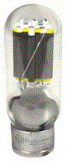
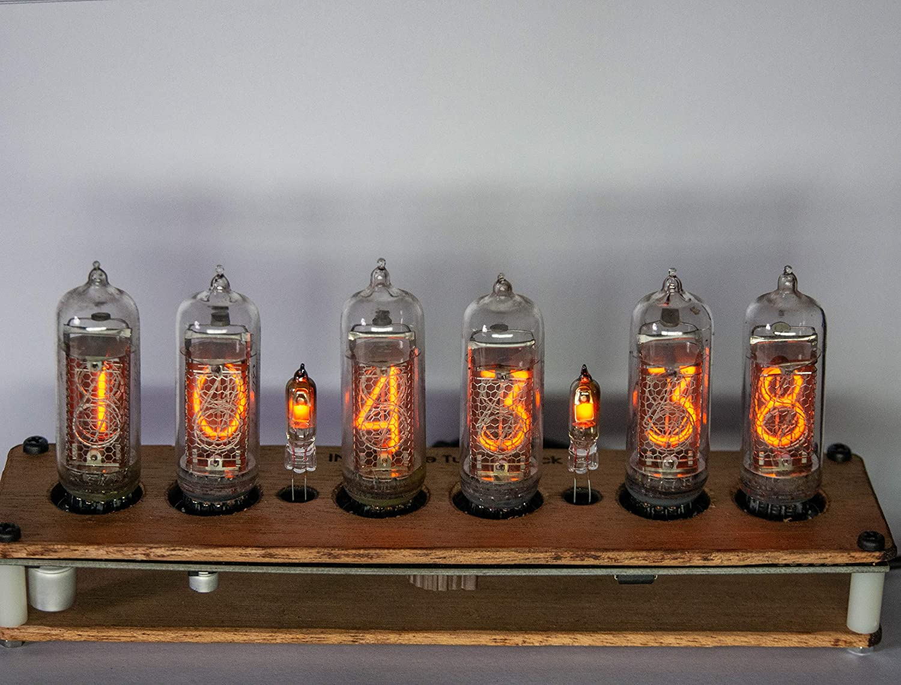
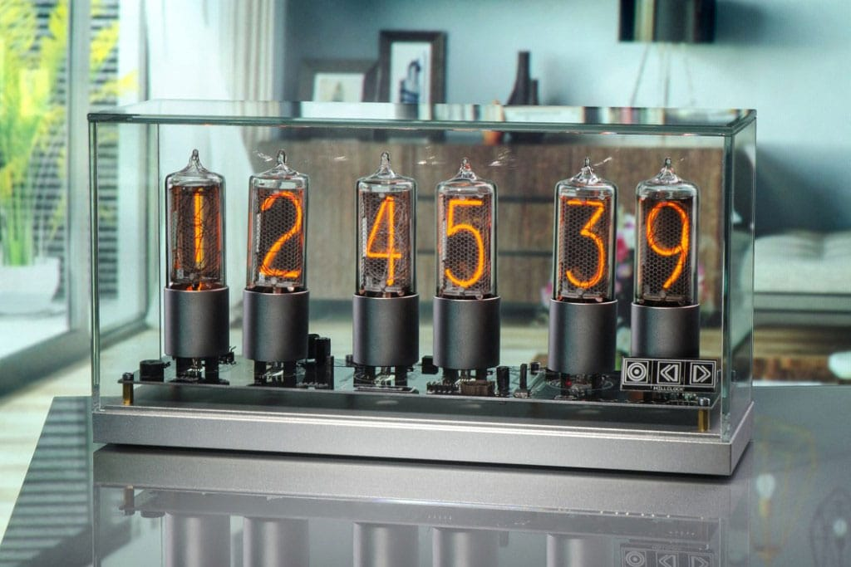
Vacuum Tubes - 1941 - 1956
First Generation Electronic Computers used Vacuum Tubes
Vacuum tubes are glass tubes with circuits inside.
Vacuum tubes have no air inside of them, which protects the circuitry.

Slide 23
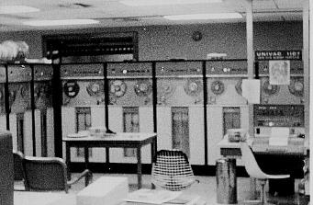
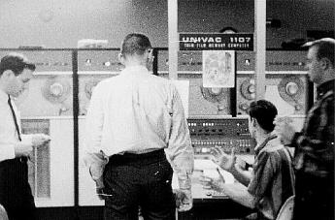
UNIVAC - 1951
first fully electronic digital computer built in the U.S.
Created at the University of Pennsylvania
ENIAC weighed 30 tons
contained 18,000 vacuum tubes
Cost a paltry $487,000
https://youtu.be/qB3Ho7ocXr8

Slide 24
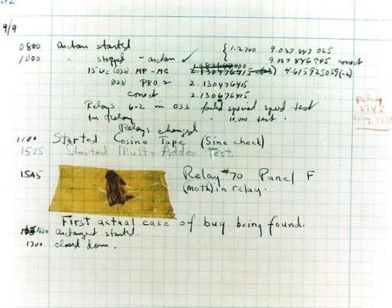
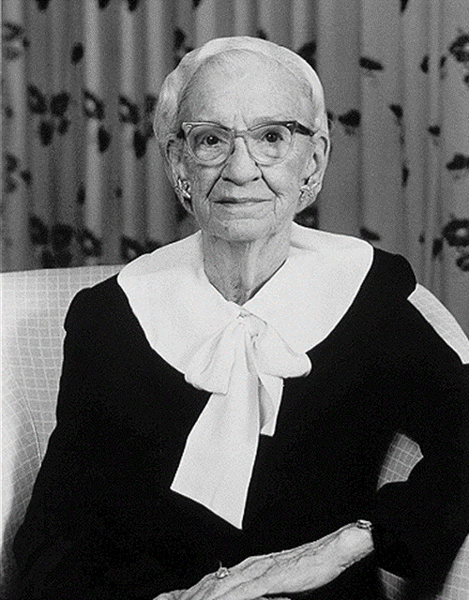
The First Computer “Bug”…….1947
Relay switches part of computers
Grace Hopper found a moth stuck in a relay responsible for a malfunction
Called it “debugging” a computer

Slide 25
Operating System
Software – Instructions for Computer
Operating system is set of instructions loaded each time a computer is started
Program is instructions loaded when needed

Slide 26
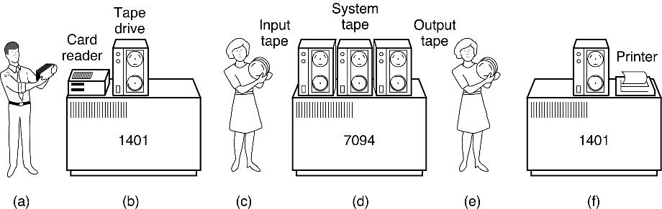
History of Operating Systems (1955–1965)
Early batch system
Single user
Secure
Programmer/user as the operator
But low CPU utilization: slow mechanical I/O devices

Slide 27
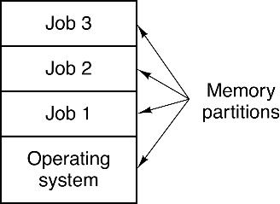
History of Operating Systems (1965–1980)
IBM produced the System/360. All the machines had the same architecture and instruction set, programs written for one machine could run on all the others.
Multiprogramming system
Three jobs in memory: 3rd generation
Spooling: use disk as very large buffer for input/output devices
Timesharing: quick response time

Slide 28
The invention of Microprocesors
Inexpensive, Interchangeable components
Widespread and Start of PC era
MSDOS 1.0 – Microsoft and IBM-PC (1981) 16 bit,
X Window OS – Unix like (since cost of components deceased) GUI
Widespread of GUI ( Apple, Windows, Amiga, Atari )
“Windows Empire” started 1989

Slide 29
Selected OS Developers
1960s
Fred Brooks (manager) – IBM OS/360
Fernando Corbató (project leader) – Multics
1970s
Dave Cutler – DEC VMS (and later Windows NT)
Dennis Ritchie and Ken Thompson – UNIX
1980s
Rick Rashid – Mach
1990s
Linus Torvalds – Linux

Slide 30
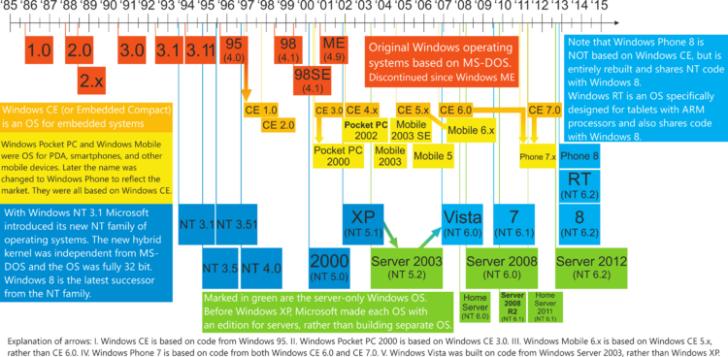
Windows Operating Systems

Slide 31
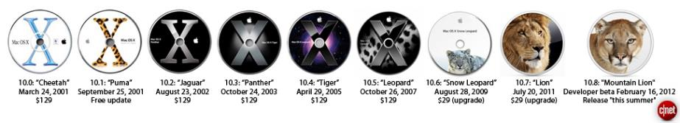
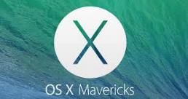
Apple Operating Systems
OS X Mavericks -2013

Slide 32
Unix Operating Systems
Ken Thompson, Dennis Ritchie -- Bell Labs 1969
4TH edition in C, portable OS 1973
Mostly used in Bell Labs by 1975
Solaris, AIX, XP-UX
Internet, Server, Networks
Apple Mac OS certified to Unix 03 Kernel

Slide 33
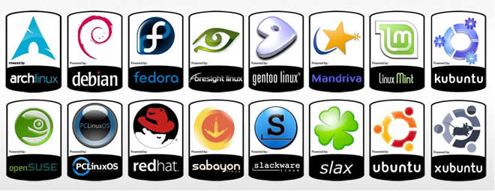
Linux Operating Systems
Linus Torvalds created MINIX 1991
Free, Open Source
First Linux Kernel September 1991
Small and medium size operations

Slide 34
Computer Performance Over Time

Slide 35
Early Operating Systems: Computers Were Very Expensive
One application at a time
Had complete control of hardware
Runtime library was a primitive OS
Users would stand in line to use the computer
Batch systems
Keep CPU busy by having a queue of jobs
OS would load next job while current one runs
Users would submit jobs and wait

Slide 36
Time-Sharing Operating Systems: Computers and People Both Expensive
Multiple users on computer at same time
Multiprogramming: run multiple programs at same time
Interactive performance: try to complete everyone’s tasks quickly
As computers became cheaper, more important to optimize for user time, not computer time

Slide 37
Today’s Operating Systems: Computers Are Cheap
Smartphones
Embedded systems
Laptops
Tablets
Virtual machines
Data center servers

Slide 38
Tomorrow’s Operating Systems
Giant-scale data centers
Increasing numbers of processors per computer
Increasing numbers of computers per user
Very large scale storage

Slide 39
Outline
Course Information
What is an OS?
History of OSes
Hardware Review
A Typical UNIX
Dual-Mode CPU Operations
Interrupts and System Calls
OS Major Components

Slide 40
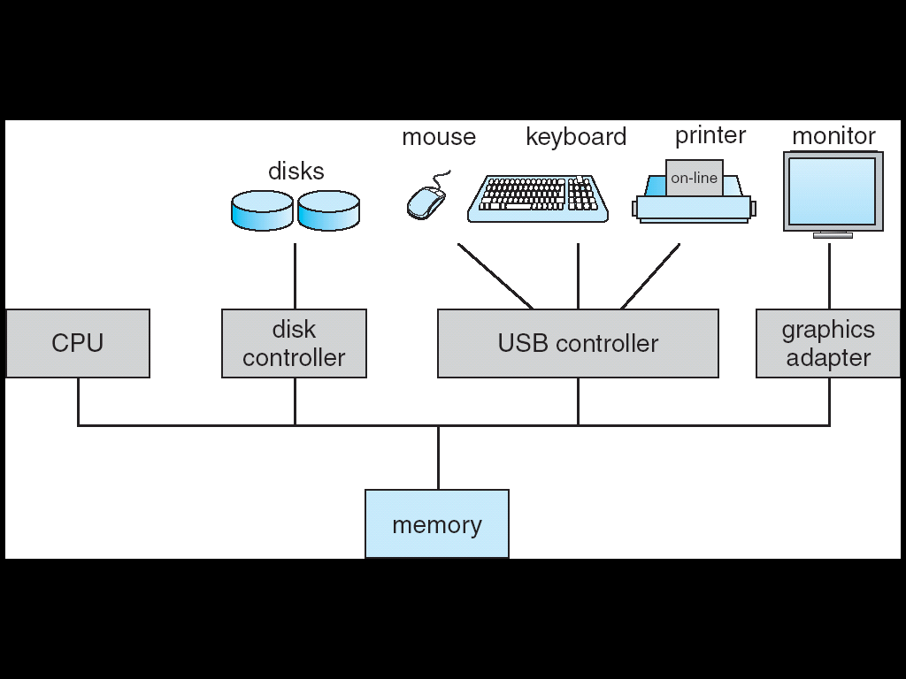
Basic (1-CPU) Computer System

Slide 41
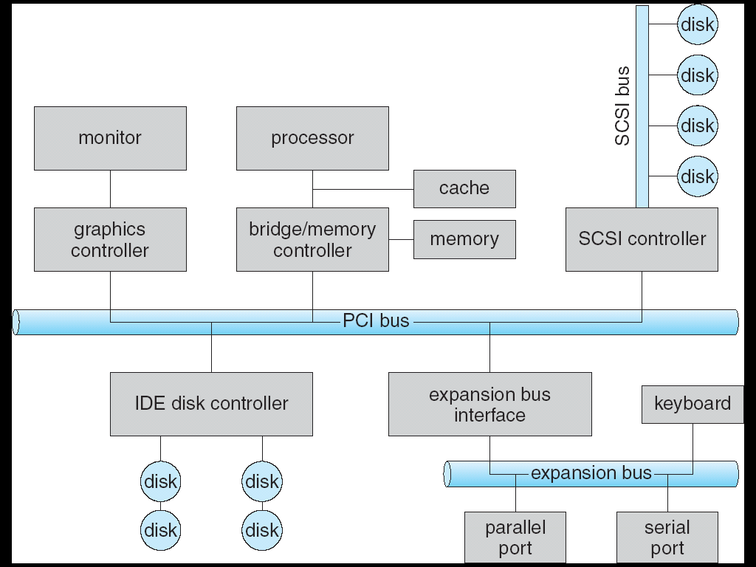
Typical PC (Intel-based) Computer Structure

Slide 42
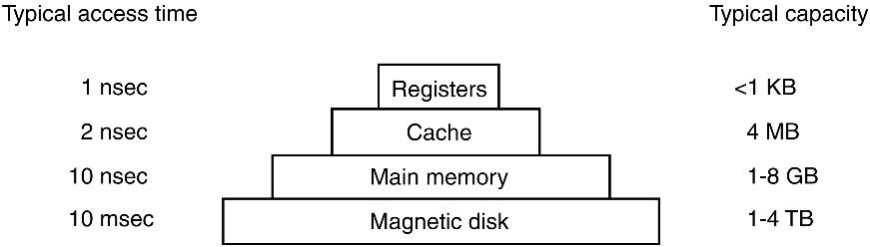
Typical Memory Storage Structure
100 msec
Magnetic tape
10-20 TB
When you program, have you thought about
Registers?
Disks?

Slide 43
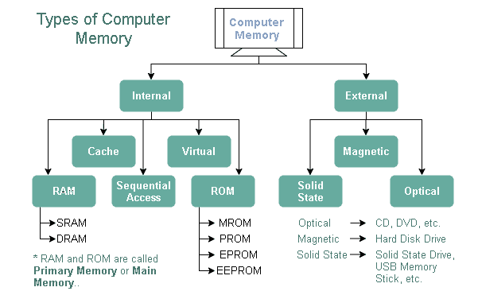
Typical Memory in a PC

Slide 44
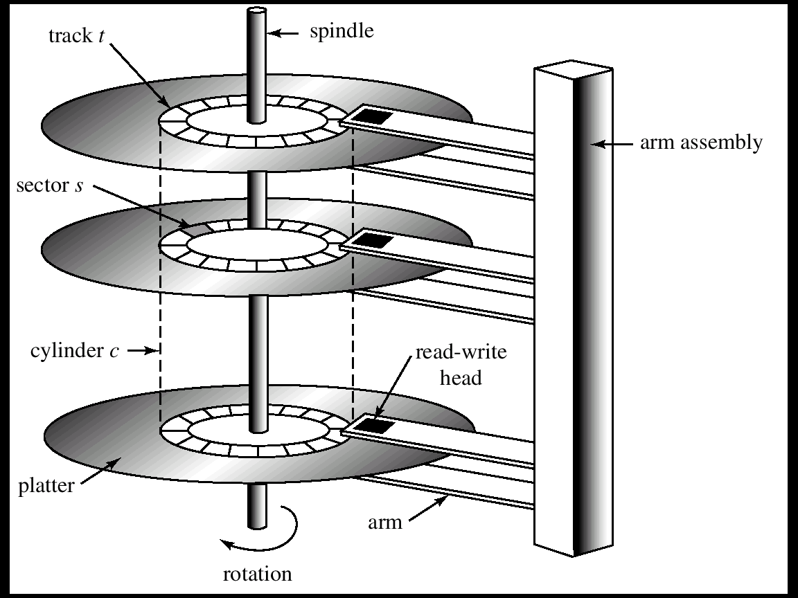
Moving-Head Disk Mechanism

Slide 45
Outline
Course Information
What is an OS?
History of OSes
Hardware Review
A Typical UNIX
Dual-Mode CPU Operations
Interrupts and System Calls
OS Major Components

Slide 46
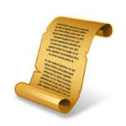
Brief History of UNIX
Programmers for Bell Labs were working on a project called Multics.
But Bell Labs eventually pulled out of this project as it was failing to deliver a useable system at this time.
A group of 4 programmers in AT&T’s Bell labs began to find an alternative.
By April 1969 a system called UNICS was developed and by that summer UNIX was developed.

Slide 47
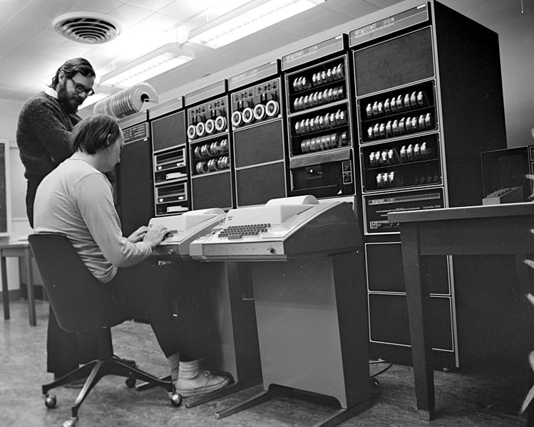
Dennis Ritchie
PDP-11
~4KB of memory
Developed in 1969 at AT&T’s Bell laboratories.
Ken Thompson
PDP-11

Slide 48
Release timeline
1969
The Beginning
1973
Fourth Edition
Rewritten in C
1971
First Edition
1975
Sixth Edition
1979
Seventh Edition
1986
Ninth Edition
1985
Eight Edition
1989
Tenth Edition
1983
Unix system V
1982
Unix system IV
1981
Unix system III
1986
Unix system V Release 3
1984
Unix system V Release 2
1987
Unix system V
Release 3,2
1988
Unix system V
Release 4
1992
Novell
Unixware 1.0
1995
Novell
Unixware 2.0
2001
SCO
Open Unix 8.0
1998
SCO
Unixware 7.0

Slide 49
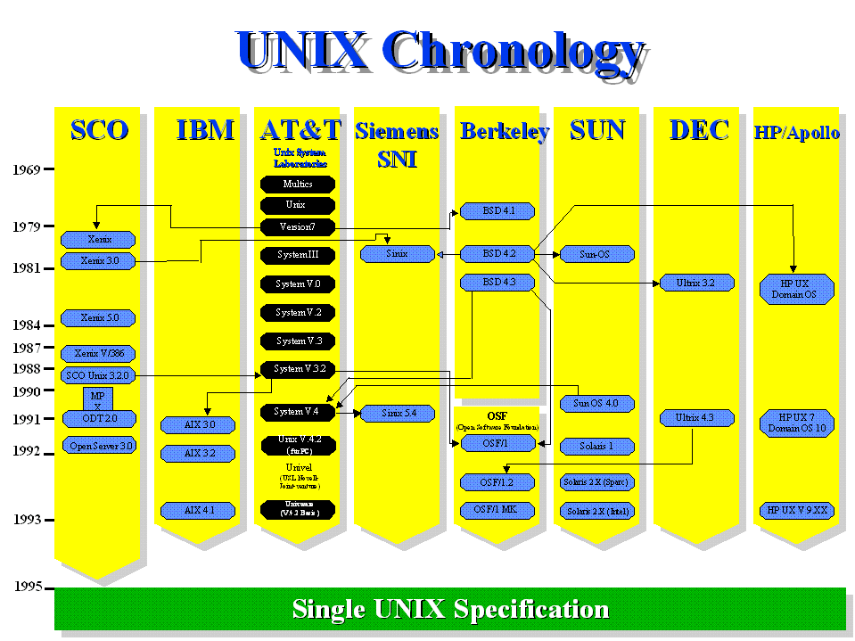
UNIX based systems

Slide 50
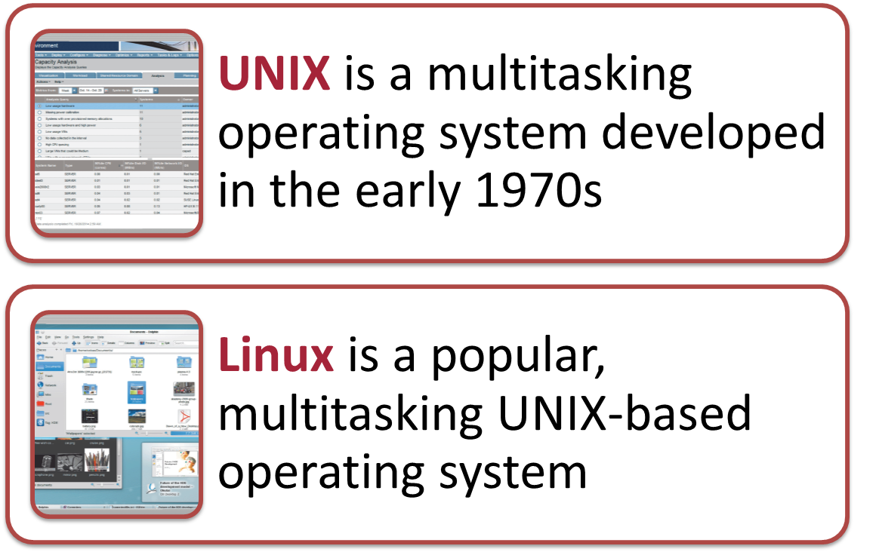
UNIX based systems
Since it began to escape from AT&T's Bell Laboratories in the early 1970's, the success of the UNIX operating system has led to many different versions.
Universities, research institutes, government bodies and computer companies all began using the powerful UNIX system to develop many of the technologies.
Soon all the large vendors, and many smaller ones, were marketing their own, versions of the UNIX system.

Slide 51

UNIX architecture
Shell
Kernel
Utilities

Slide 52
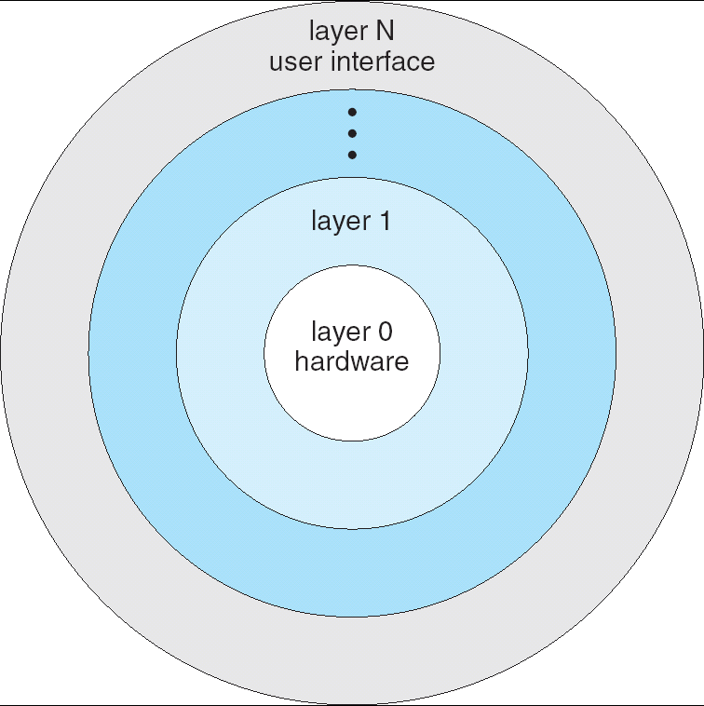
Layered Operating System

Slide 53
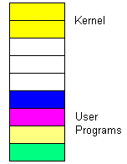
UNIX architecture
Kernel
File management
Memory management
IO management
Process management
Shell
Interprets user commands
executes user commands
Interface between the user and the kernel
Utilities
User made programs
Editors and compilers
System memory

Slide 54
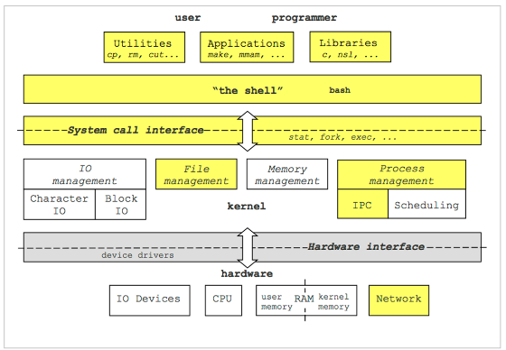
UNIX architecture

Slide 55
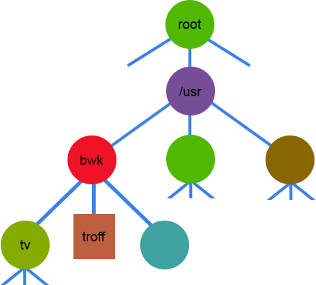
UNIX File Hierarchy
All data stored in UNIX is considered to be a file.
directory
directory
Parent level
Home Directory
directory
file
directory
"Everything is a file"

Slide 56
UNIX File Types
Ordinary Files
written text.
located under a directory file.
Doesn’t contain other files.
Directories
Branching points to other directories.
Can contain ordinary files, special files or other directories.
Special Files
Can represent real physical devices such as a printer, keyboards, terminal.
Two types of I/O: Character and block.
Pipes
Pipes are used to link programs together.

Slide 57
The Shell
[prompt]$ <command> <flags> <args>
blk:~$ ls –l –a
(Optional) arguments
Command Prompt
Command
(Optional) flags

Slide 58
Single UNIX Specification 1998
The Single UNIX Specification is an industry standard description of the C language program and user command interfaces for a standard Unix operating system.
An operating system is allowed to use the UNIX trademark if it follows this spec.
It was developed to ensure that a program developed in one Unix operating system would run in a somewhat different Unix operating system.
The specification is owned by The Open Group, an industry group which oversees UNIX certification and branding.

Slide 59
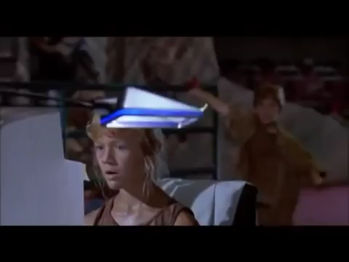
Even the Internet itself, all began life with and because of UNIX systems. Today, without UNIX systems, the Internet would come to a screeching halt. Most telephone calls could not be made, electronic commerce would grind to a halt and there would have never been "Jurassic Park"!

Slide 60
A Peek Into Unix
Application
Libraries
User space/level
Portable OS layer
Kernel space/level
Machine-dependent layer

Slide 61
Unix: Application
Application (e.g., emacs)
Written by programmer
Compiled by programmer
Uses function calls
Libraries
Machine-dependent layer
Portable OS layer

Slide 62
Unix: Libraries
Application
Written by elves
Provided pre-compiled
Defined in headers
Input to linker (compiler)
Invoked like functions
May be “resolved” when program is loaded
Libraries (e.g., stdio.h)
Machine-dependent layer
Portable OS layer

Slide 63
Typical Unix OS Structure
Application
Libraries
Machine-dependent layer
Portable OS layer
System calls (read(), open(), etc.)
All “high-level” code

Slide 64
Typical Unix OS Structure
Application
Bootstrap
System initialization
Interrupt and exception
I/O device driver
Memory management
Kernel/user mode switching
Processor management
Libraries
Machine-dependent layer
Portable OS Layer

Slide 65
Discussion
What will future operating systems (OSes) look like?
20–30 years from now?
What are the problems for current OSes? How can future OSes fix them?
What features will future OSes have?
What are the criteria to evaluate the OSes?

Slide 66
Outline
Course Information
What is an OS?
History of OSes
Hardware Review
A Typical UNIX
Dual-Mode CPU Operations
Interrupts and System Calls
OS Major Components

Slide 67
Questions
Why kernel and user mode?
How?

Slide 68
Why Kernel Mode?
Services that need to be provided at kernel level
System calls: file open, close, read/write
Control the CPU so that users won’t get stuck by running
while ( 1 ) ;
Protection:
Keep user programs from crashing OS
Keep user programs from crashing each other
How do we achieve these?

Slide 69
How to Provide Kernel Mode?
CPU mode bit added to computer hardware to indicate current CPU mode: 0 (kernel) or 1 (user).
When interrupt occurs, CPU hardware switches to kernel mode.
Switching to user mode (from kernel mode) done by setting CPU mode bit (by an instruction).
Exception/Interrupt/Fault
kernel
user
Set user mode
Privileged instructions can be executed
only in kernel mode.

Slide 70
Outline
Course Information
What is an OS?
History of OSes
Hardware Review
A Typical UNIX
Dual-Mode CPU Operations
Interrupts and System Calls
OS Major Components

Slide 71
Three Interrupt Classes
Interrupts caused by hardware failures
Power outage
Memory parity error
Interrupts caused by external events:
Reset
I/O devices
Interrupts caused by executed instructions
Exceptions
System calls

Slide 72
Interrupts by External Events
Reset
IRQ 1
IRQ 0
Timer

Slide 73
Interrupts Caused by
Instruction Execution
Exceptions: caused by errors during instruction execution:
Address Error: a reference to a nonexistent or illegal memory address;
Reserved Instruction: An instruction with undefined opcode field or a privileged instruction in user mode;
Integer Overflow: An integer instruction results in a two’s complement overflow;
Floating Point Error: e.g., divide by zero, overflow, underflow
Special instructions:
MIPS processors: Syscall instruction executed
Intel processors: INT n instruction executed

Slide 74
Hardware Handling of Interrupts
Save the addresses of the interrupted instruction
Transfer control to the appropriate interrupt service routine (software)
Sets CPU to kernel mode
May do some security checks here

Slide 75
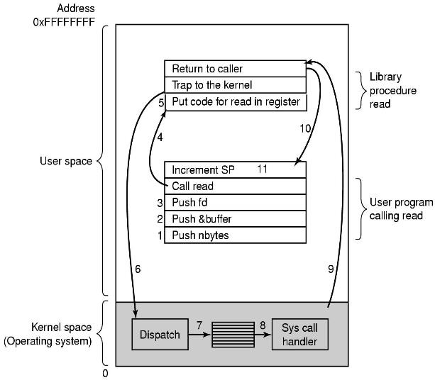
System Call Steps
Example:
read(fd, buffer, nbytes)

Slide 76
Outline
Course Information
What is an OS?
History of OSes
Hardware Review
A Typical UNIX
Dual-Mode CPU Operations
Interrupts and System Calls
OS Major Components

Slide 77
OS Major Components
Process management
Resource management
CPU
Memory
I/O devices
File system
Bootstrap
Design Issues 1. Efficiency 2. Fairness 3. Sharing 4. Protection

Slide 78
Process Management (1)
What is a process?
Is it a program?
In short: it’s a program that is executing
What does a process need?
CPU time, memory, files, and I/O devices

Slide 79
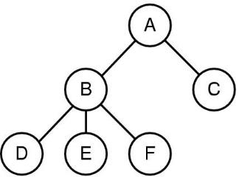
Process Management (2)
How to create/terminate processes?
fork()
execve()
kill()
exit()
What else from OS?
Process synchronization
Process communication
Deadlock handling

Slide 80
CPU Management
Responsibilities
CPU scheduling
Allocation for multiple CPUs
Issues:
CPU utilization
Fairness
Deadlock free

Slide 81
Memory Management
Why?
Multiple programs in limited memory
Responsibilities:
Track memory usage
Allocation/De-allocation
Transfer from and to secondary storage

Slide 82
I/O Devices
Why?
Too many details
Too many different devices
Responsibilities
Improve I/O efficiency, utilization
General interfaces
Extensible for specific hardware devices
Kernel
Kernel I/O Subsystem
SCSI
device
driver
Keyboard
device
driver
……
ATAPI
device
driver
SCSI
device
controller
Keyboard
device
controller
……
ATAPI
device
controller
SCSI
devices
Keyboard
devices
……
ATAPI
devices

Slide 83
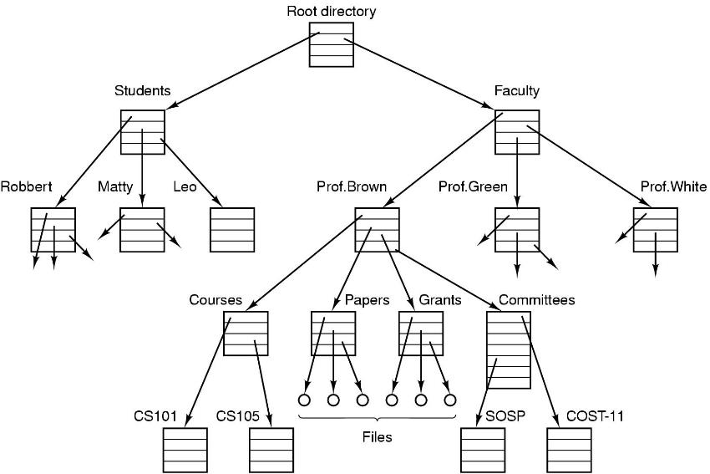
File System Example

Slide 84
File System
Why?
A easy way for users/apps to manipulate information
How to create/open/close/delete files/directories?
open()
close()
link()
unlink()

Slide 85
The Future of Operating Systems
Will continue to become more user-friendly
Will eventually be driven primarily by a voice interface
Likely to continue to become more stable and self-healing
Will likely continue to include improved security features and to support multiple processors and other technological improvements
May be used primarily to access software available through the Internet or other networks

Slide 86
Summary
Course Overview
What is an OS?
History of OS
Hardware Review
A Typical UNIX
Dual-Mode CPU Operations
Interrupts and System Calls
OS major components

